Slide 1


Supervised Learning Classification
© All rights reserved by Fireblaze Technologies Pvt. Ltd.

Slide 2
K Nearest Neighbour
© All rights reserved by Fireblaze Technologies Pvt. Ltd.

Slide 3
Agenda
Introduction to K Nearest Neighbour
Uses and applications of KNN
KNN Working
Optimum value of Factor K in KNN
Pros and Cons of KNN
© All rights reserved by Fireblaze Technologies Pvt. Ltd.

Slide 4
Introduction to KNN
KNN stands for K-Nearest Neighbors
KNN is a model that classifies data points based on the points that are most similar to it.
The model representation for KNN is the entire training dataset.
KNN is an algorithm that is considered both non-parametric and an lazy learning.
KNN belong to Supervised learning method.
© All rights reserved by Fireblaze Technologies Pvt. Ltd.

Slide 5
Uses and applications of KNN
KNN is often used in simple recommendation systems, image recognition technology, and decision-making models.
KNN can be used for both classification and regression.
© All rights reserved by Fireblaze Technologies Pvt. Ltd.

Slide 6
KNN Working
For Classification : If you are using K and you have an even number of classes (e.g. 2) It is a good idea to choose a K value with an odd number to avoid a tie. And the inverse, use an even number for K when you have an odd number of classes.
For Regression : When KNN is used for regression problems the prediction is based on the mean of the K-most similar instances.
© All rights reserved by Fireblaze Technologies Pvt. Ltd.

Slide 7
KNN Working
KNN makes predictions using the training dataset directly.
For regression this might be the mean output variable, in classification this might be the mode (or most common) class value.
Distance Measure used.
For real-values input variables, the most popular distance measure in ‘Euclidean Distance’.
Euclidean distance is calculated as the square root of the sum of the squared differences between a new point (x) and an existing point (xi) across all input attributes j.
Euclidean Distance(x, xi) = sqrt( sum( (xj – xij)^2 ) )
© All rights reserved by Fireblaze Technologies Pvt. Ltd.

Slide 8
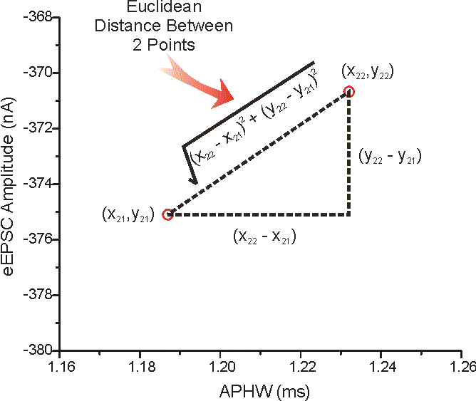
KNN Working - Euclidean
© All rights reserved by Fireblaze Technologies Pvt. Ltd.

Slide 9
KNN Working
Other popular distance measure is :
Manhattan Distance: Calculate the distance between real vectors using the sum of their absolute difference. Also called as Block Distance. It is replace by a new metric in which the distance between two points is the sum of absolute difference.
There are many other distance measure, such as Tanimoto, Jaccard, Mahalanobis, and cosine distance.
© All rights reserved by Fireblaze Technologies Pvt. Ltd.

Slide 10
KNN Working - Manhattan
Manhattan Distance :- |X1-X2| + |Y1-Y2|
Y1
Y2
X1 X2
© All rights reserved by Fireblaze Technologies Pvt. Ltd.

Slide 11
KNN Working
Euclidean is a good distance measures to use if the input variables are similar in types. i.e. all measured widths and heights.
Manhattan distance is a good measure to use if i/p variables are not similar in types i.e. age, gender, height etc.
K values from 1 to 21.
KNN increase when have a large size of training data.
© All rights reserved by Fireblaze Technologies Pvt. Ltd.

Slide 12
KNN Working
K-NN algorithm uses ‘feature similarity’ to predict the value of new data point.
Step 1 : Load all dataset and assign the value of K. i.e. K = 3,5,7,9…...
Step 2 : For each point in the test data do the following.
Calculate the distance between points.
Now, based on the distance value, sort them in ascending order.
Next, it will choose the top K from sorted array.
Now, it will assign a class to the test point based on most frequent class.
Step 3 : End
© All rights reserved by Fireblaze Technologies Pvt. Ltd.

Slide 13
KNN Working
Category 1
Category 2
Category 1
Category 2
© All rights reserved by Fireblaze Technologies Pvt. Ltd.

Slide 14
Pros and Cons of KNN
Pros
Learning and implementation is extremely simple and Intuitive.
Flexible decision boundaries
Cons
Irrelevant or correlated features have high impact and must be eliminated.
Typically difficult to handle high dimensionality
Computational costs: memory and classification time computation
© All rights reserved by Fireblaze Technologies Pvt. Ltd.

Slide 15
Thank you
© All rights reserved by Fireblaze Technologies Pvt. Ltd.

